Slide 1
Classical Image Classification Pipeline
OpenCV + HOG + Color Histogram + SVM (RBF)
Prepared by : we bare bears

Slide 2
Project Goal
The goal of the project was to classify different types of balls using classical image processing and machine learning techniques.
Classes included:
Basketball
Football
Tennis Ball
Baseball
Golf Ball
American Football

Slide 3
Milestone 2 goal
We may use any image processing functions, techniques, or feature extraction methods they find suitable to achieve the best possible detection and classification accuracy. Aber wie haben wir das geschafft?!!!!!!!!!!!

Slide 4
Dataset Preparation
The dataset was organized into:
train folder → used for training
test folder → used for evaluation
Each class had its own folder.
Example: train/ basketball/ football/ tennis ball/
The folder names became the class labels automatically.
Which will make labeling classes much easier in the upcoming steps

Slide 5
Image Preprocessing
Each image went through several preprocessing steps:
Resize Images : All images were resized to: 256×256
Purpose: Ensure all images have the same dimensions
Reduce computational complexity
2) Convert Color Space
Images were converted from:
BGR → HSV
Purpose:
HSV separates color and brightness
More robust against lighting changes

Slide 6
Image Preprocessing
3)Gaussian Blur
A Gaussian filter was applied:
5×5
Purpose:
Reduce image noise
Smooth unwanted details
Improve feature extraction quality

Slide 7
Feature Extraction
The system extracted two types of features:
1) HOG Features (Histogram of Oriented Gradients)
HOG extracts: edges ,gradients ,shapes & textures.
Process: Convert image to grayscale ,Detect edge directions, Build gradient histograms, Create numerical feature vector
Purpose: Capture object shape and texture information
2) Color Histogram Features
Histograms were calculated for: Hue (H)Saturation (S)Value (V).
Purpose: Capture color distribution of each ball
Example: Basketball → orange , Tennis ball → green ,Baseball → white

Slide 8
Feature Combination
The HOG features and HSV histogram features were combined into one large feature vector.
Final feature vector:
[HOG Features | Color Features]
Purpose:
Combine shape information with color information
Improve classification accuracy

Slide 9
Feature Normalization
The features were normalized using: Scikit-learn StandardScaler.
Normalization formula: z=x−μ/σ
​Purpose:
Scale all features equally
Prevent large values from dominating training
Improve SVM performance

Slide 10
Model Training
The classifier used was:
Support Vector Machine (SVM)
with: RBF kernel
C = 10, C controls how strict the model is about classifying the training data correctly.
gamma = scale , was useful because it automatically adapted to the size and distribution of the features.
Purpose: Learn boundaries between ball classes
Handle nonlinear classification problems
The model was trained using: extracted feature vectors
corresponding class labels

Slide 11
Model Testing
The trained SVM predicted labels for unseen test images.
Predictions were compared with actual labels to evaluate performance.

Slide 12
Performance Evaluation
Several evaluation metrics were used:
Accuracy Measures overall prediction correctness:
Accuracy= Correct Predictions​/Total prediction
Classification Report
Included:
Precision
Recall
F1-score for each class.
Confusion Matrix
Visualized:
correct predictions
classification errors
using a heatmap.

Slide 13
Prediction Visualization
The system displayed:
test image
predicted label
actual label
to visually inspect model performance.

Slide 14
Final Pipeline Overview
Dataset
Resize Images
Image Loading
HSV Conversion
Gaussian Blur
HOG Feature Extraction
HSV Color Histogram Extraction
Feature Combination
Feature Normalization
SVM Training
Prediction
Accuracy & Confusion Matrix

Slide 15
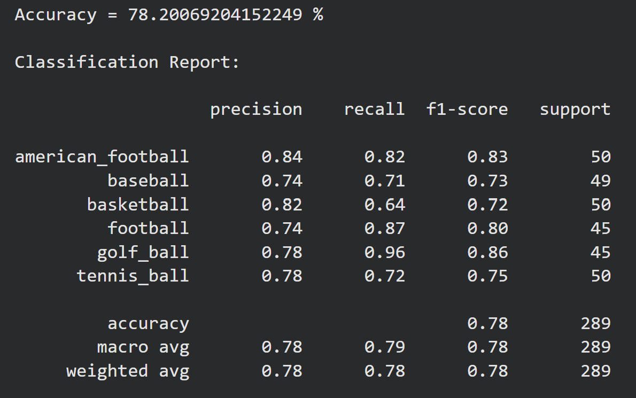
Results
Precision → How many predicted images were actually correct.
Recall → How many real images of a class were successfully found.
F1-score → Combined measure of precision and recall.
Higher F1-score means better overall performance for that class.
Support → Number of test images in each class.
Accuracy → Overall percentage of correctly classified images across all classes.

Slide 16
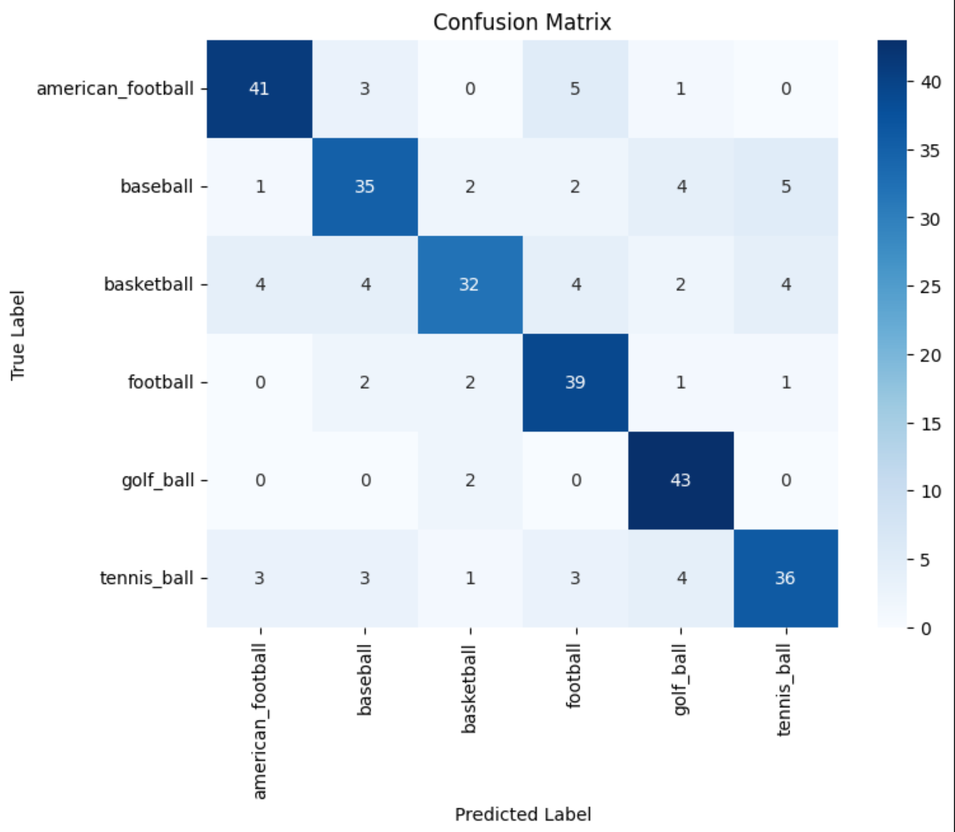
Results
The confusion matrix shows the model’s correct and incorrect predictions for each class.
Most correct predictions are on the diagonal (dark blue boxes).
golf ball performed best with 43 correct predictions and very few mistakes.
American football` was classified correctly 41 times, but sometimes confused with `football`.
Football also performed well with 39 correct predictions.
Basketball had more classification errors, showing it was harder for the model to recognize.
`baseball` and `tennis_ball` were sometimes confused with other ball types because of visual similarity.
Overall, the matrix shows good performance with some confusion between similar-looking sports balls.

Slide 17
Conclusion
This milestone demonstrated a complete classical computer vision pipeline using:
OpenCV
HOG feature extraction
HSV color histograms
SVM classification
The combination of shape and color features allowed the model to successfully classify different types of balls with high accuracy.

Slide 18
Milestone 3
Milestone Goal
Build an image classification model without using pretrained models
Create a CNN completely from scratch
Classify ball images into 6 categories

Slide 19
Dataset Preparation & Preprocessing
Dataset divided into:
Training set
Testing set
Images organized into folders by class
All images resized to:
224 × 224
Batch size set to: 32
Applied preprocessing before training:
Pixel normalization (rescale = 1/255)
Rotation augmentation
Zoom augmentation
Horizontal flipping
Purpose:
increase dataset diversity
improve generalization
reduce overfitting

Slide 20
CNN Model Architecture
Step | Layer | Output / Function | Purpose
1 | Input Layer | 224 × 224 × 3 | Input RGB image enters the CNN
2 | Conv2D | 32 filters, 3×3 | Detect basic features like edges and corners
3 | BatchNormalization | — | Stabilizes training and improves convergence
4 | MaxPooling2D | 2×2 | Reduces image size while keeping important features
5 | Conv2D | 64 filters, 3×3 | Learns more detailed shapes and patterns
6 | BatchNormalization | — | Normalizes activations
7 | MaxPooling2D | 2×2 | Downsamples feature maps
8 | Conv2D | 128 filters, 3×3 | Learns more complex object features
9 | BatchNormalization | — | Improves training stability
10 | MaxPooling2D | 2×2 | Further feature reduction
11 | Conv2D | 256 filters, 3×3 | Captures high-level visual features
12 | BatchNormalization | — | Keeps learning stable
13 | MaxPooling2D | 2×2 | Reduces dimensions before classification
14 | Flatten | 1D feature vector | Converts feature maps into a vector
15 | Dense | 256 neurons + ReLU | Learns high-level image patterns
16 | Dropout | 0.5 | Reduces overfitting
17 | Dense | 128 neurons + ReLU | Further classification learning
18 | Dropout | 0.3 | Improves generalization
19 | Output Layer | 6 neurons + Softmax | Predicts one of the 6 ball classes

Slide 21
Model Compilation & Model Training
Configured training with:
Optimizer:
Adam updates the weights during training.
It helps the model learn by minimizing error.
Learning Rate 0.0001
Loss Function: Categorical Cross entropy
Metric :Accuracy
Trained using model. Fit()
Validation performed on testing data
Training setup: Maximum epochs: 10

Slide 22
Model Evaluation & results
Evaluated the model on unseen test images.
Final Result:
Test Accuracy = 86%
This means the CNN correctly classified 86% of test images.

Slide 23
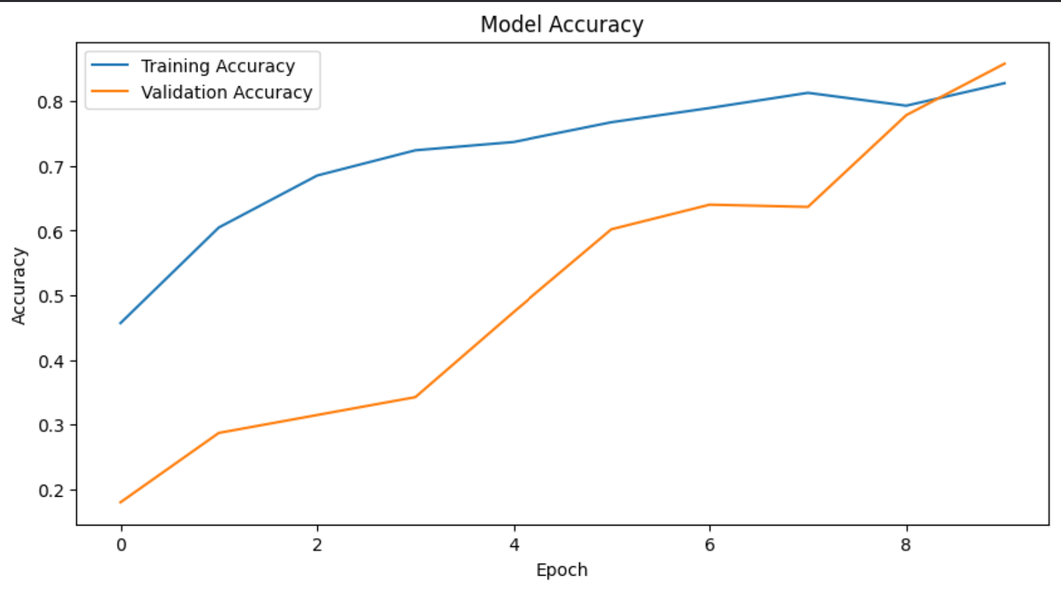
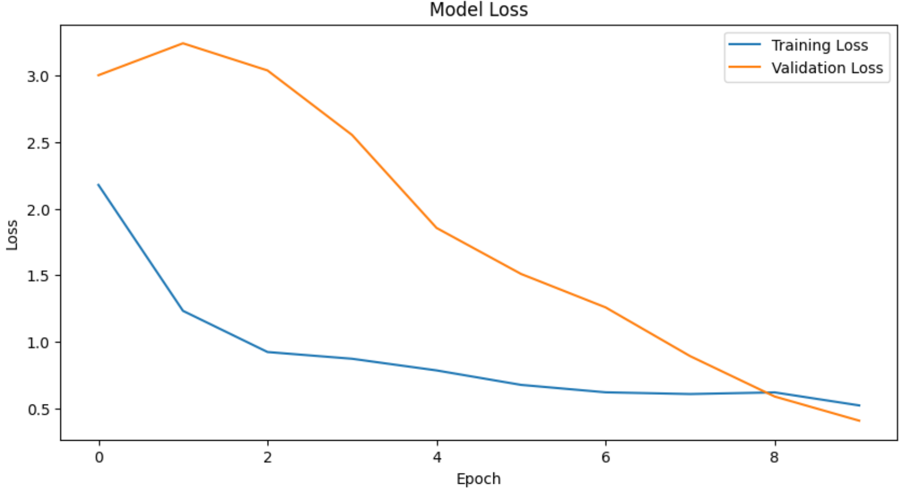
Model Evaluation & results

Slide 24
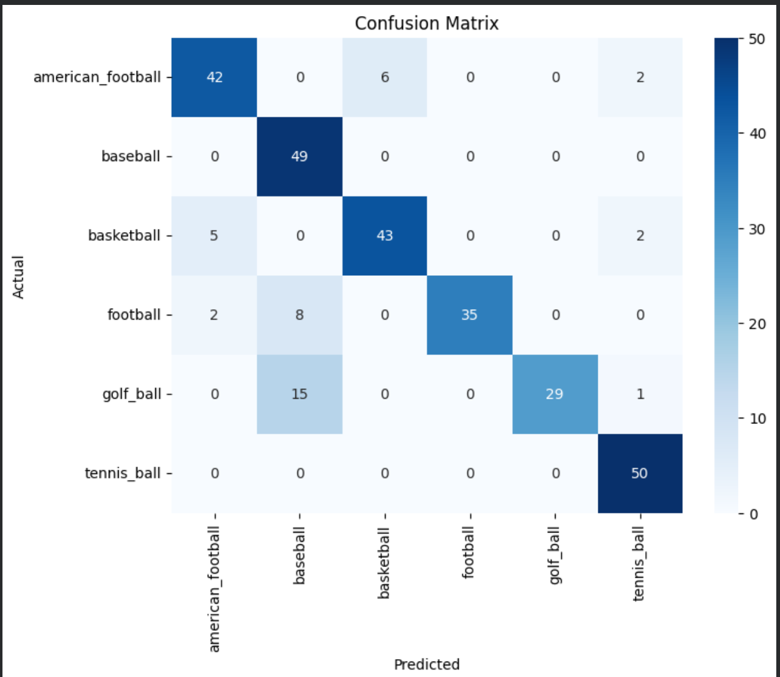
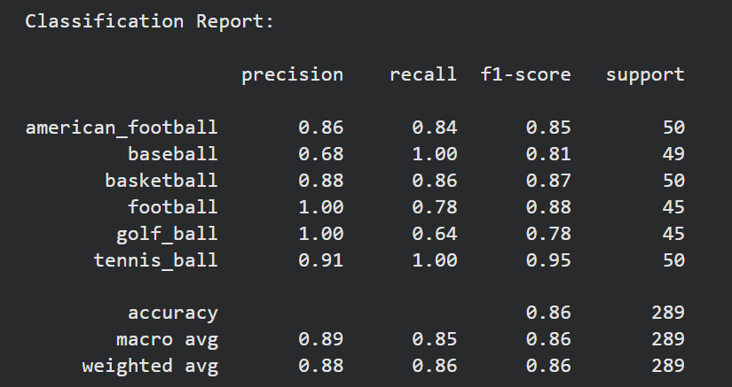
Model Evaluation & results

Slide 25
A Convolutional Neural Network was successfully built entirely from scratch for ball image classification. The model achieved 86% test accuracy across 6 classes. Results show that a custom CNN can perform well without transfer learning, with strongest performance on baseball and tennis ball classification.

